Slide 1
MovieFlix
20XX
WebApp

Slide 2
About the project idea
This movie streaming web app .customers need to register with they email address and make a new account.
The editors can add new movies
Customers need to pay and they can watch the movies
Movie Recommented system based generes and users rating system
Paypal
Movie playing
20XX

Slide 3
Technologies
20XX
Prototypes/Diagrams
Frond end
Adobe XD
C4
Back end
Angular 11
Material UI
Deployment
Spring boot(2.4.3)
Flask
Testing
Docker
Selenium

Slide 4
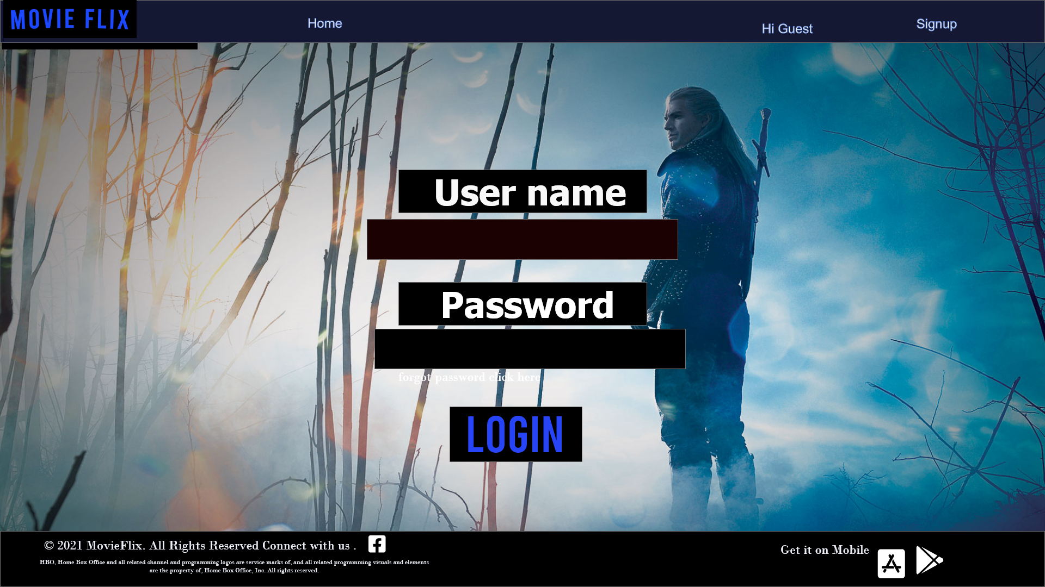
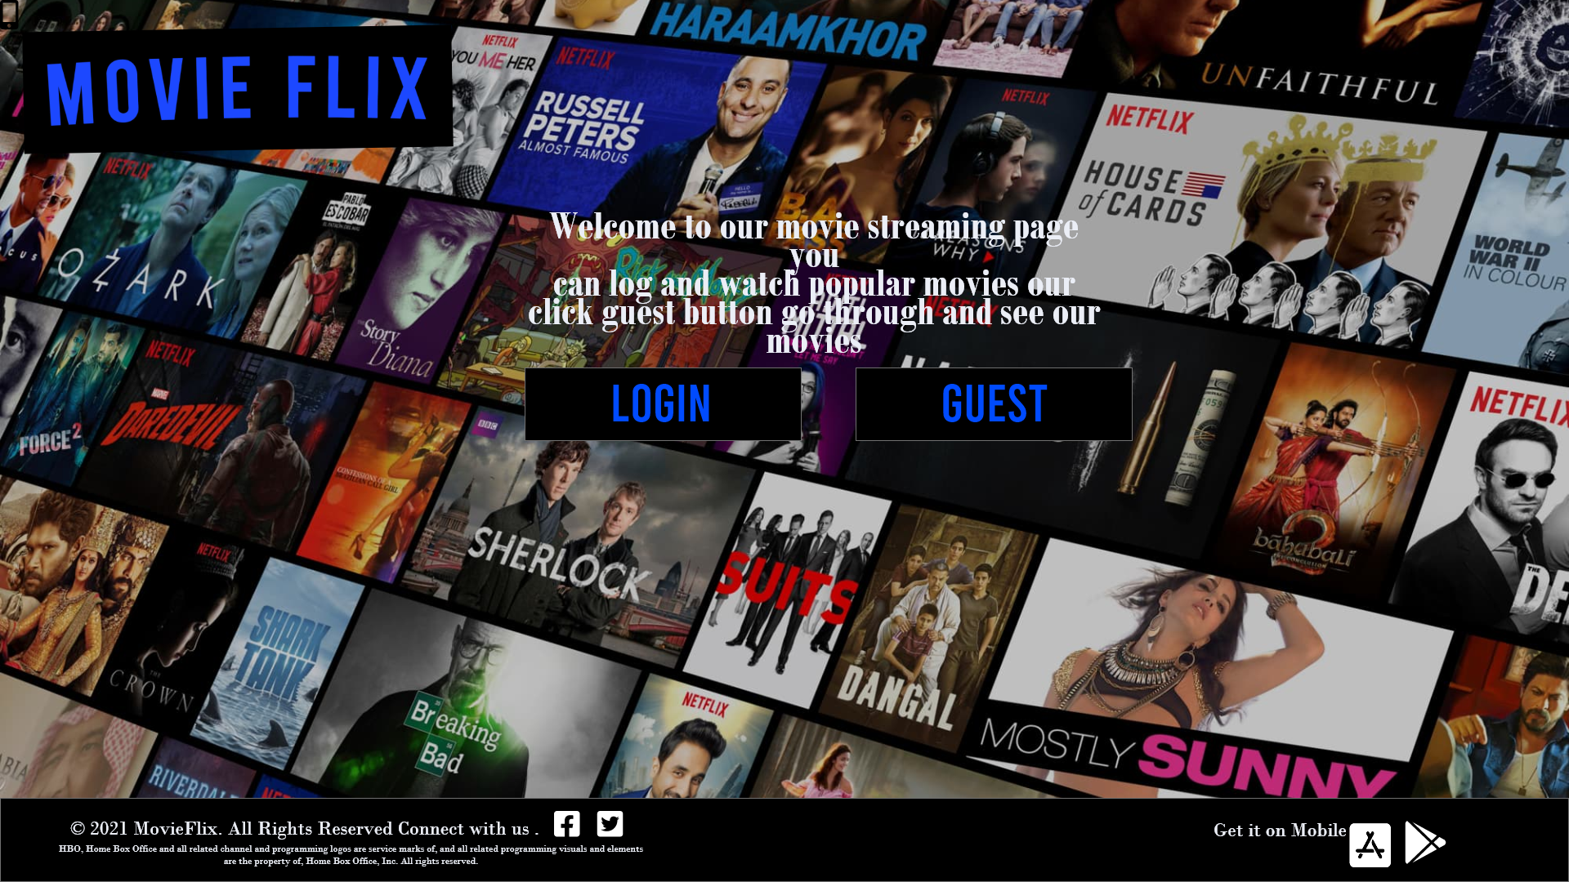
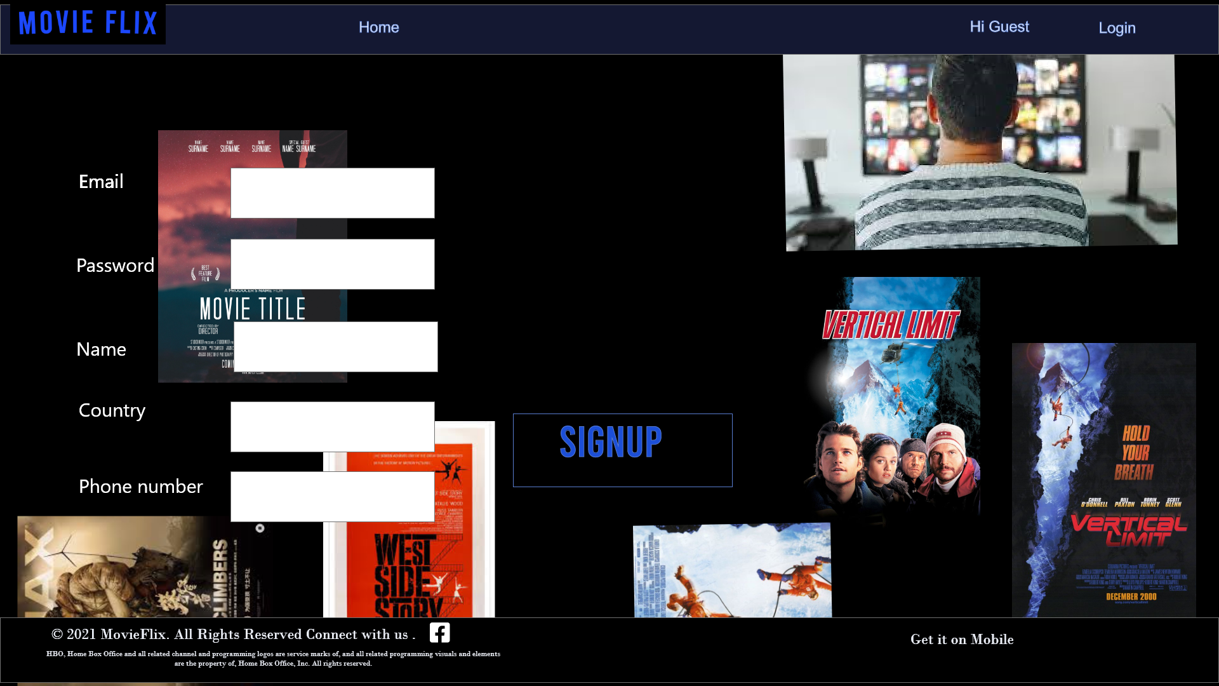
UI Design
20XX

Slide 5
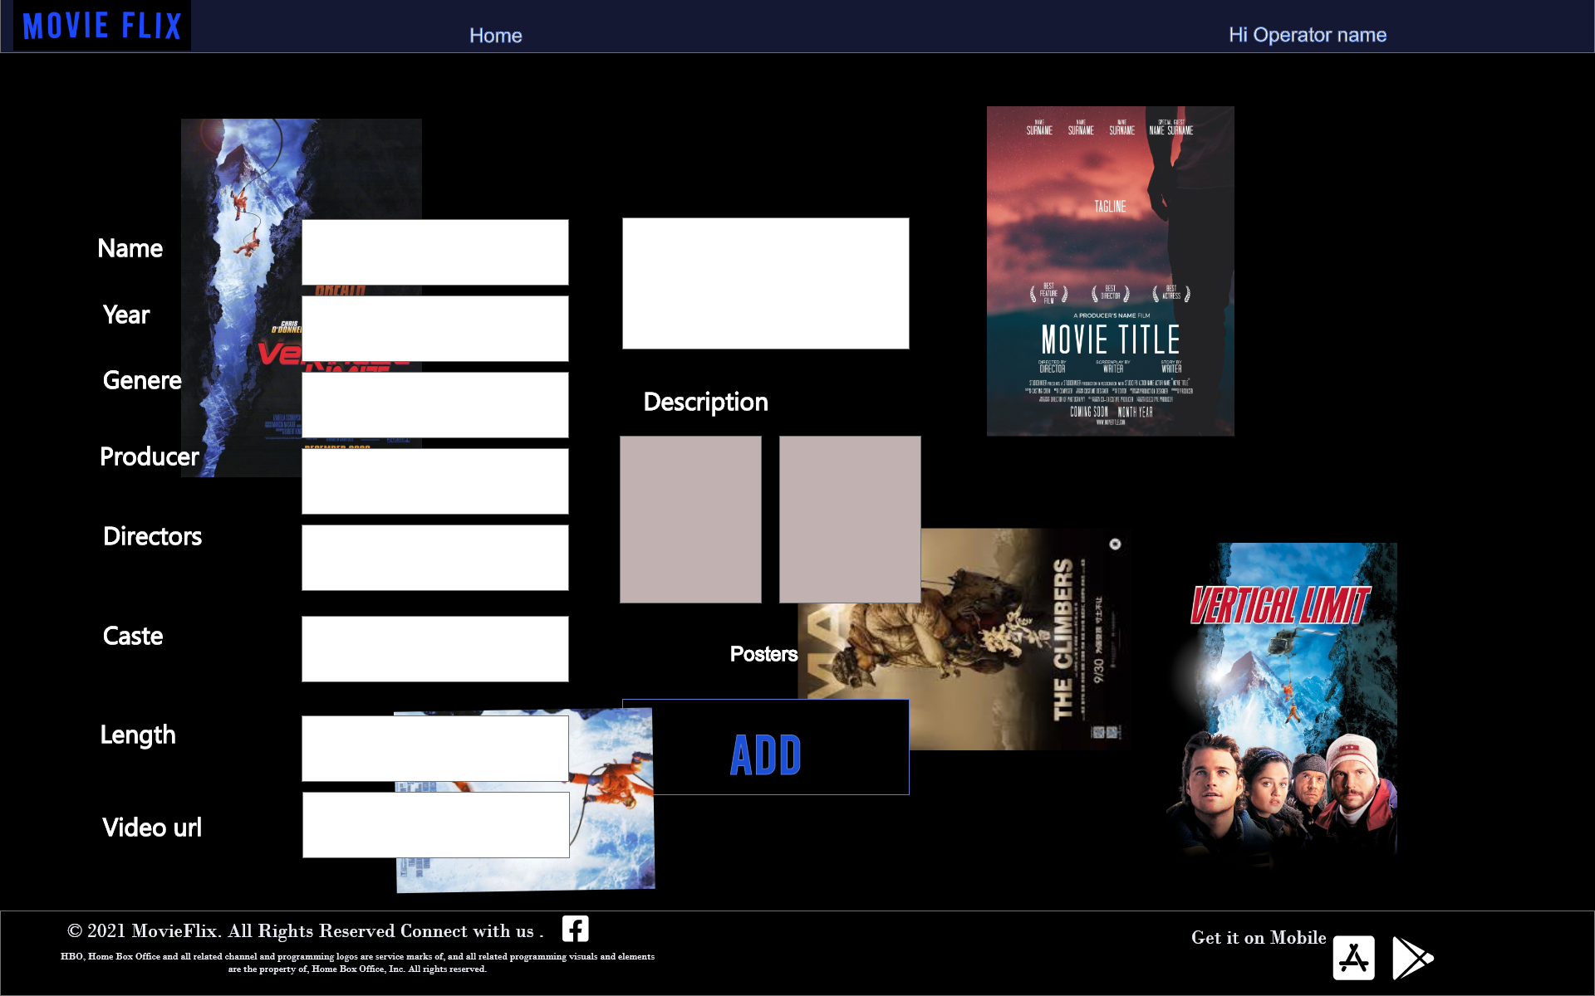
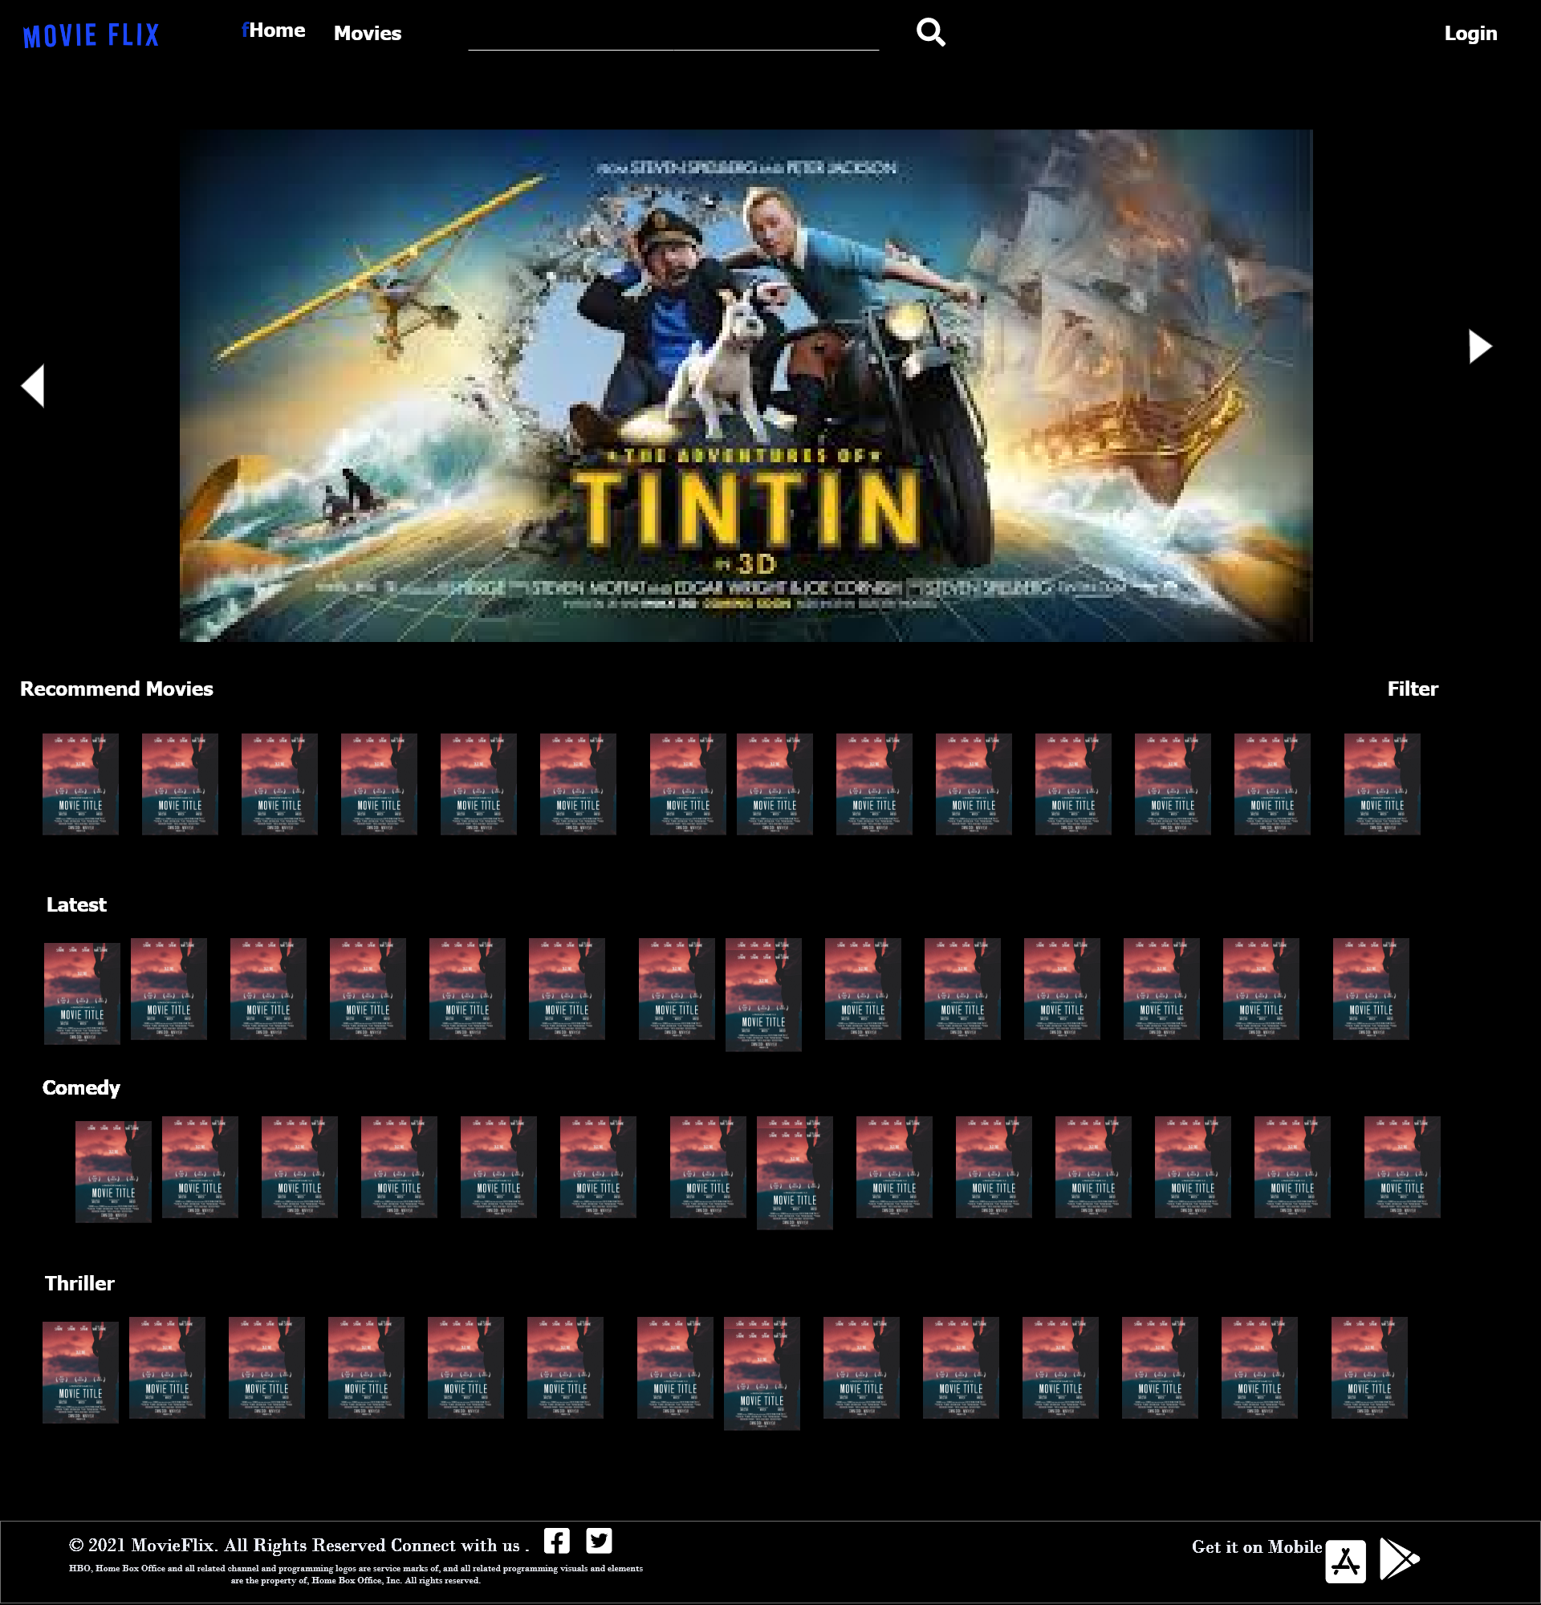
UI Design
20XX

Slide 6
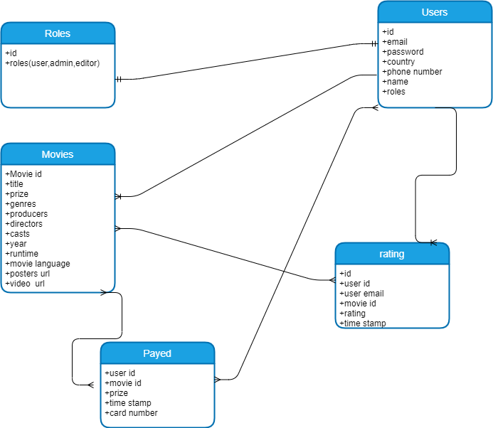
DB Schema
20XX

Slide 7
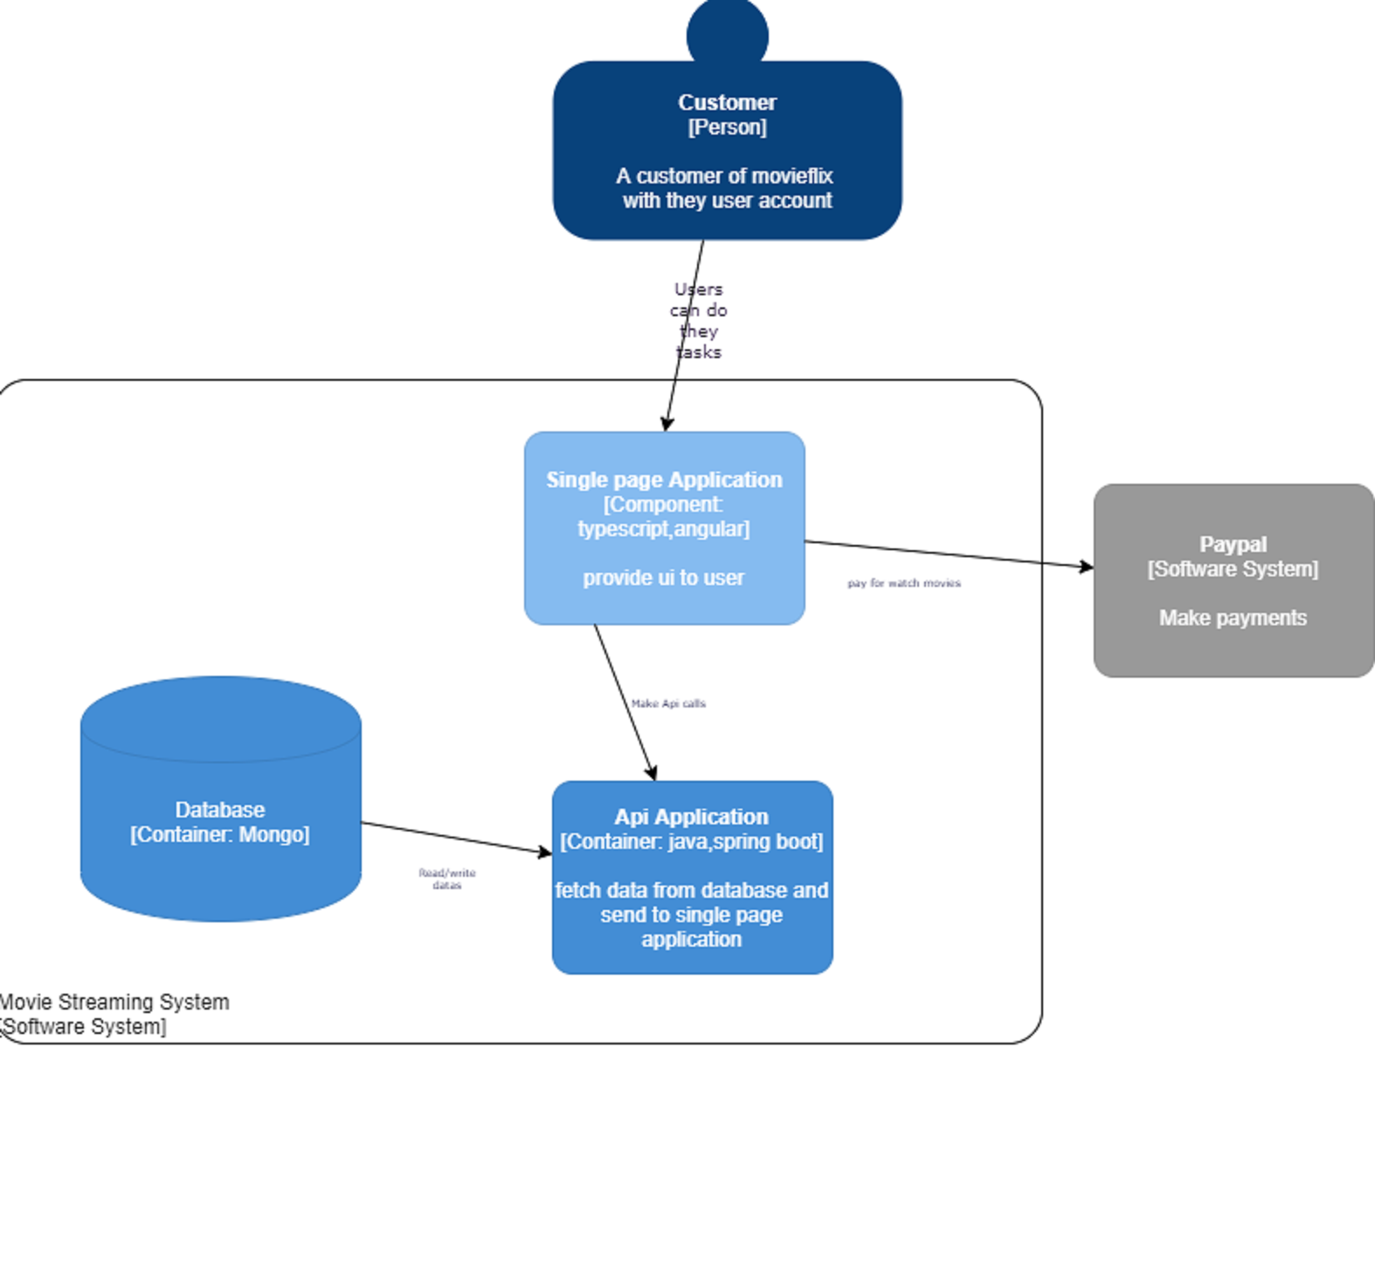
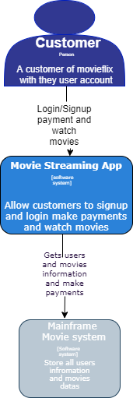
Diagrams-C4
Container
20XX
Context

Slide 8
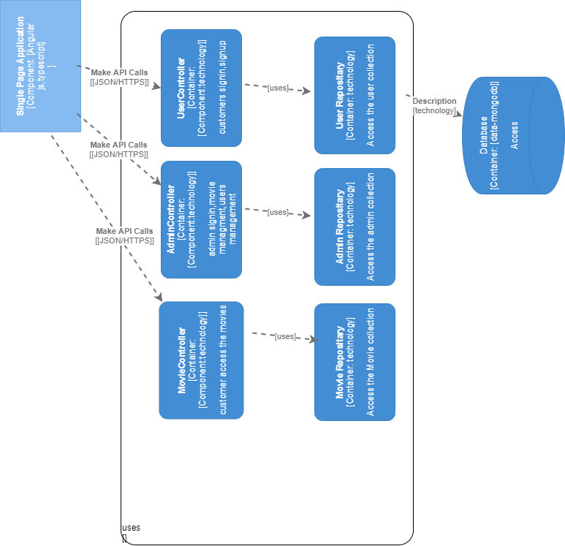
Diagrams-C4
20XX

Slide 9
THANK YOU!
20XX

